Slide 1


In association with
“Business Analytics with R”
Group-E presents…

Slide 2


EPISODEs:
Predicting Employee Churn at Dunder Mifflin Paper Company
Data Exploration & Visualization
[Classification] Decision Tree
[Classification] Logistic Regression

Slide 3

Episode 1: DATA EXPLORATION & VISUALIZATION

Slide 4

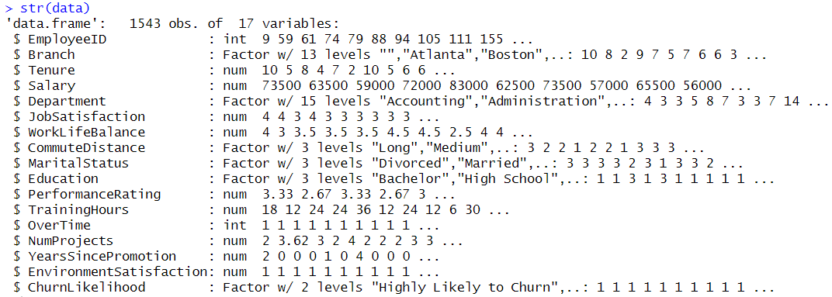
1.1 Each Variables Statistics And Specification
Structure of the dataset:
1543 observations (i.e., rows) and 17 variables (i.e. attributes or columns)
There are 11 variables are numeric and 6 variables are categoric variables

Slide 5
No. | Each Variables Statistics and Specification | Mean | Std. | Min. | Max.
1) | Employee ID: A unique identifier for each employee. | 772.0 | 445.6 | 1.0 | 1543.0
2) | Tenure: The number of years the employee has been with the company. | 7.6 | 4.1 | 0.0 | 27.0
3) | Salary: The employee's annual salary. | 66653.6 | 8448.9 | 40000 | 98000
4) | Job Satisfaction: The employee's self-reported job satisfaction level | 3.4 | 1.1 | 1.0 | 5.0
5) | WorkLife Balance: Employee's work-life balance rating | 3.8 | 0.5 | 2.0 | 5.0
6) | Years Since Promotion: Number of years since the employee's last promotion. | 1.2 | 2.1 | 0.0 | 16.0
7) | Training Hours: The number of hours of training the employee has received. | 34.1 | 21.6 | 5.2 | 96.0
8) | Over Time: Whether the employee works overtime or not. | 0.9 | 0.2 | 0.0 | 1.0
9) | Num Projects: Number of projects the employee is currently working on. | 3.5 | 0.7 | 1.5 | 6.4
10) | Performance Rating: The employee's performance rating | 3.5 | 0.4 | 1.6 | 5.0
11) | Environment Satisfaction: Employee's environment satisfaction | NA | NA | NA | NA
12) | Churn Likelihood: Employee's likelihood to leave the company | NA | NA | NA | NA
13) | Department: The department in which the employee works | NA | NA | NA | NA
14) | Commute Distance: The distance the employee commutes to work | NA | NA | NA | NA
15) | Marital Status: The marital status of the employee | NA | NA | NA | NA
16) | Education: The highest level of education attained by the employee | NA | NA | NA | NA
17) | Branch: The "Branch" feature represents the geographic location of each employee | NA | NA | NA | NA
Dependent
Variable
Independent
Variables

Slide 6
1.2 Outlier Detection by using Box Plot and Pre-processing
# Load data from the CSV file into a data frame named 'data'
data <- read.csv("output_file (2).csv", header=TRUE, stringsAsFactors=TRUE)
# Display the structure of the data frame
str(data)
# Identify numeric columns in the data frame using sapply and is.numeric
numeric_cols <- sapply(data, is.numeric)
# Subset the data frame to include only numeric columns
numeric_data <- data[, numeric_cols]
# Subset the data frame to include only non-numeric columns
non_numeric_data <- data[, !numeric_cols]
# Normalize the numeric data using z-score normalization
normalized_data <- as.data.frame(scale(numeric_data))
# Create a box plot for the ‘TrainingHours' column
boxplot.default(normalized_data$TrainingHours,range= 2.5,col = "lightblue",main="Box Plot for TrainingHours")
# Create a box plot for the ‘WorklifeBalance' column
boxplot.default(normalized_data$WorkLifeBalance,range= 2.0 ,col = "lightgreen",main="Box Plot for WorklifeBalance")
# Create a box plot for the ‘Numofprojects' column
boxplot.default(normalized_data$NumProjects,range= 2.0 ,col = "grey",main="Box Plot for Numofprojects")
# Create a scatter plot for ‘TrainingHours’, ' WorklifeBalance’, 'NumProjects’.
ggplot(normalized_data)+geom_point(mapping
=aes(normalized_data$WorkLifeBalance,normalized_data$PerformanceRating),col="red")
ggplot(normalized_data)+geom_point(mapping = aes(normalized_data$NumProjects,normalized_data$PerformanceRating),col="blue")
ggplot(normalized_data)+geom_point(mapping = aes(normalized_data$NumProjects,normalized_data$WorkLifeBalance),col="maroon")
Outliers
-2
Maximum
(Q3+1.5*IQR)
-1
Q3(75%)
0
Interquartile Range(IQR)=Q3-Q1
Median
IQR
1
Q1(25%)
Minimum
(Q3-1.5*IQR)
2
Outliers

Slide 7
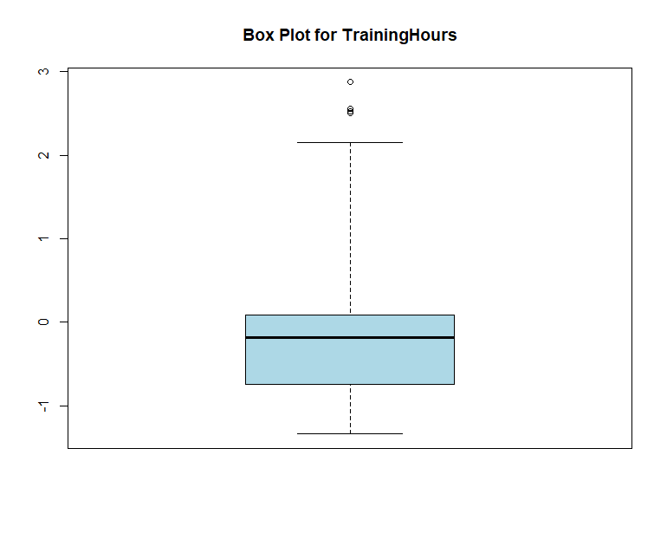
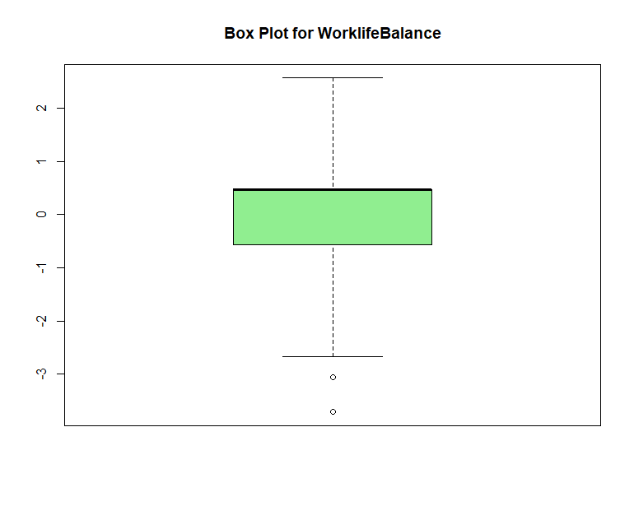
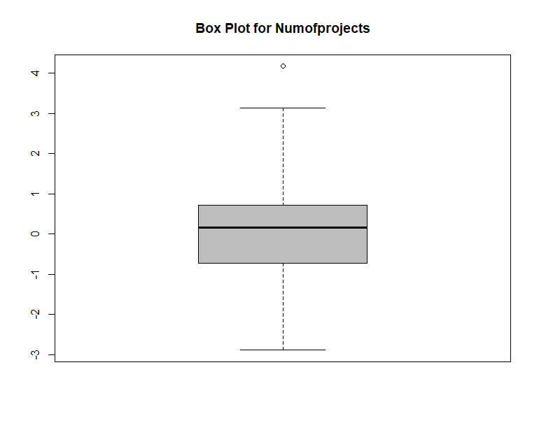
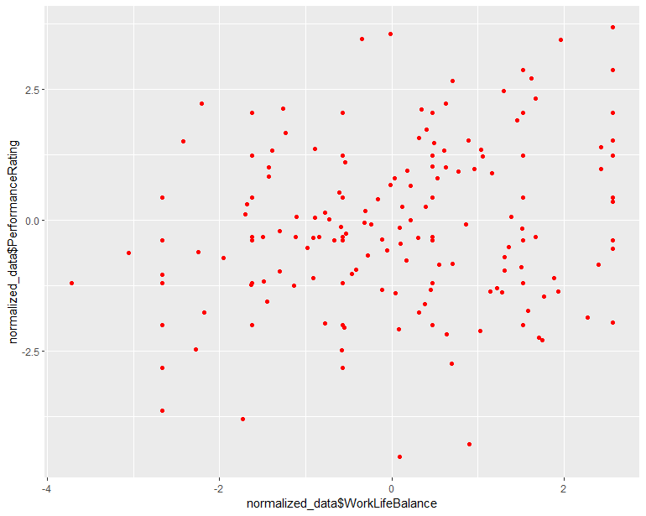
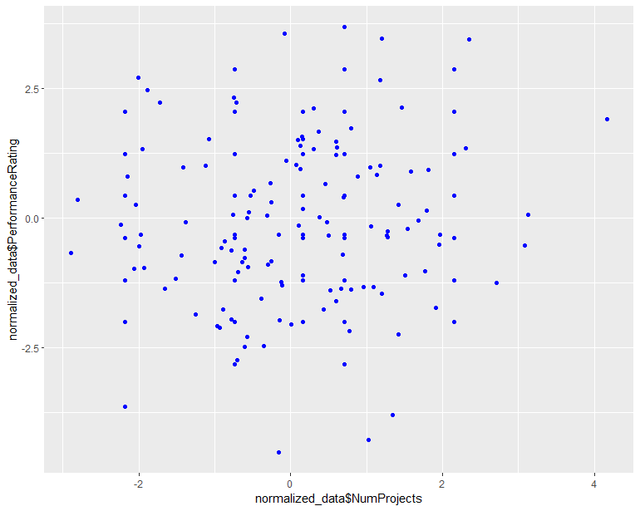
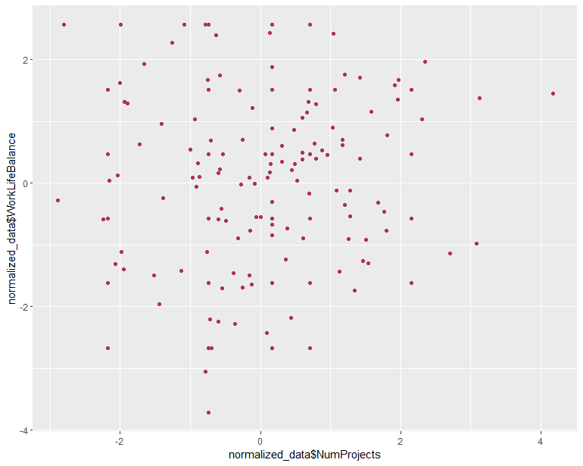

Slide 8


Episode 2: [Classification] Decision Tree

Slide 9
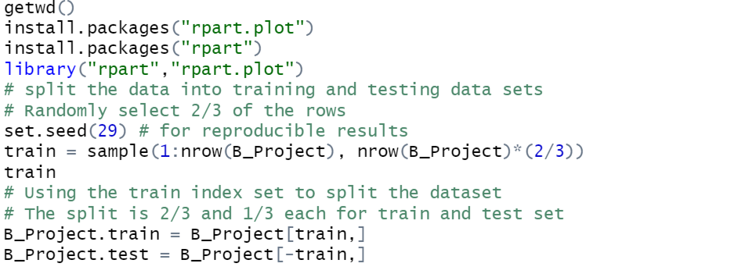
2.1 Splitting the data into training and test data

Slide 10
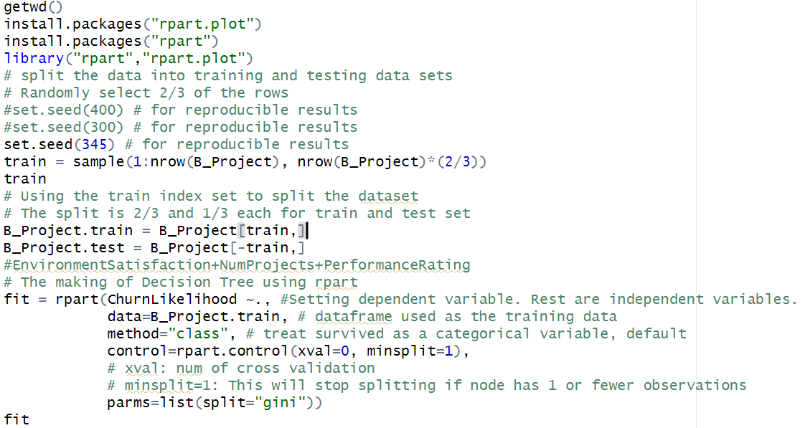
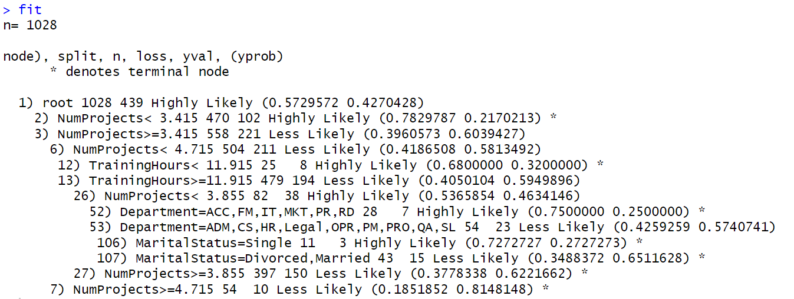
2.2 Growing a tree and display basic results
INPUT:
OUTPUT:

Slide 11
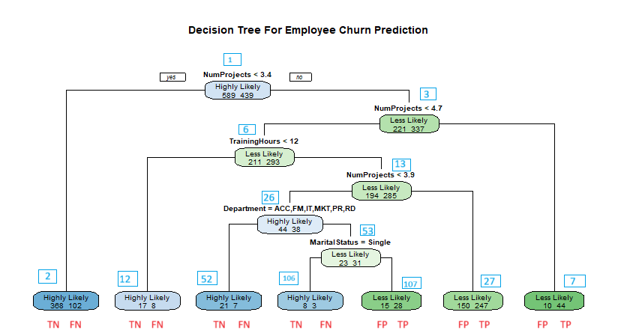
2.3 Plotting a tree and make an interpretation
R code: rpart.plot(fit, type = 1, extra = 1,main ="Decision Tree For Employee Churn Prediction")
Tree Interpretation
Definitions
True Positive (TP):
Pred Pos & Actual Pos
TP = 28+247+44=319
False Positive (FP):
Pred Pos & Actual Neg
FP = 15+150+10=175
True Negative (TN):
Pred Neg & Actual Neg
TN =368+17+21+8= 414
False Negative (FN):
Pred Neg & Actual Pos
FN =102+8+7+3=120

Slide 12
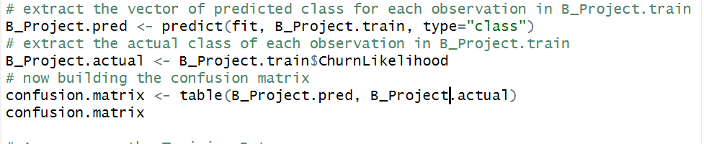
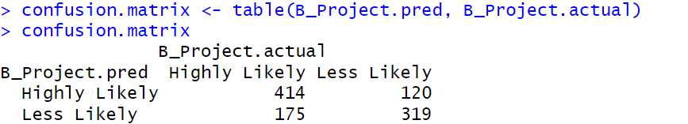
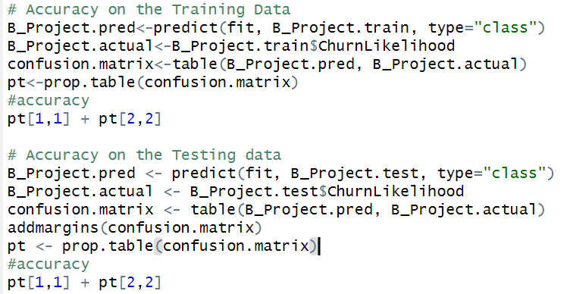
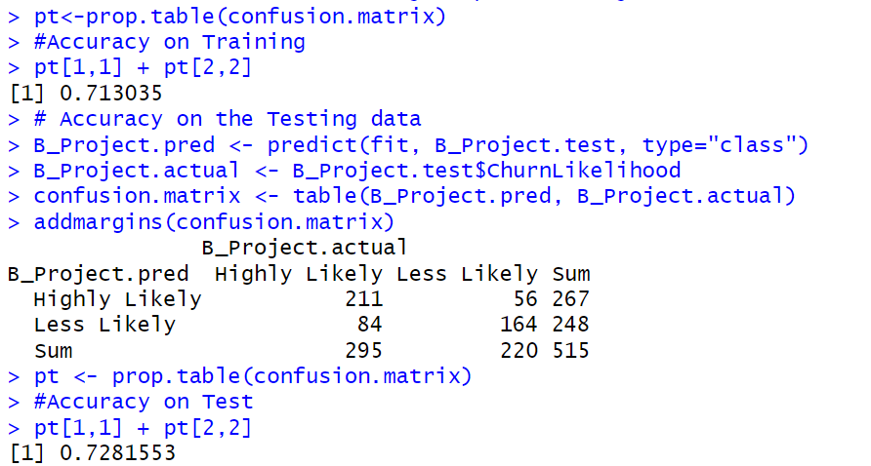
2.4 Accuracy on the training & test data
INPUT:
OUTPUT:
*Overall Performance Accuracy (0.713)
Total Correct / Total Number of Obs.
(TP + TN)/ (TP+FP+TN+FN)= (319+414)/
(319+414+175+120) = 0.713
Error Rate = Total Incorrect / Total Number of Obs. = 1 – Accuracy = 1-0.713 = 0.287
TPR = Recall = (Sensitivity) = TP/P = 319/(319+175) = 0.646
TNR = (Specificity) = TN/N = 414/(414+120) = 0.775
FPR = FP/N = Type 1 Error Rate (α)= 175/(494) = 0.354
FNR = FN/P = Type 2 Error Rate (β)= 120/(534) = 0.225

Slide 13



Slide 14

Episode 3: [Classification] Logistic Regression
No one’s leaving the room until u watch the...

Slide 15
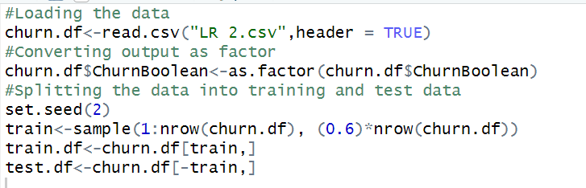
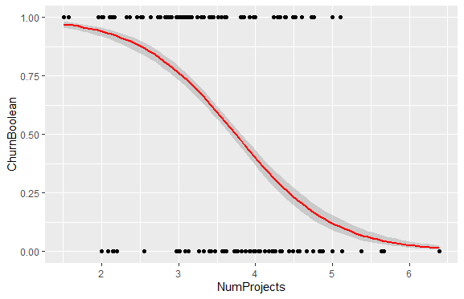
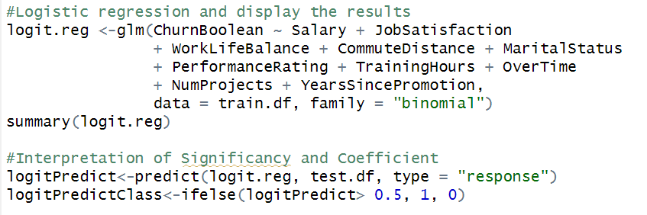

3.2 Logistic regression and display the results
3.1 Splitting the data into training and test data
INPUT: Loading and Splitting The Data
INPUT: Logistic Regression Model and Summary
$$Log Odds, Logit:$$
$\ln\left(\frac{y}{1−y}\right)=$ b₀ + b₁(X)
$\ln\left(\frac{y}{1−y}\right)=$ 7.260 – 1.546 (NumProjects)

Slide 16
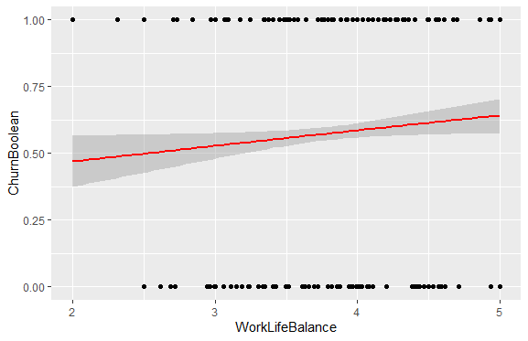
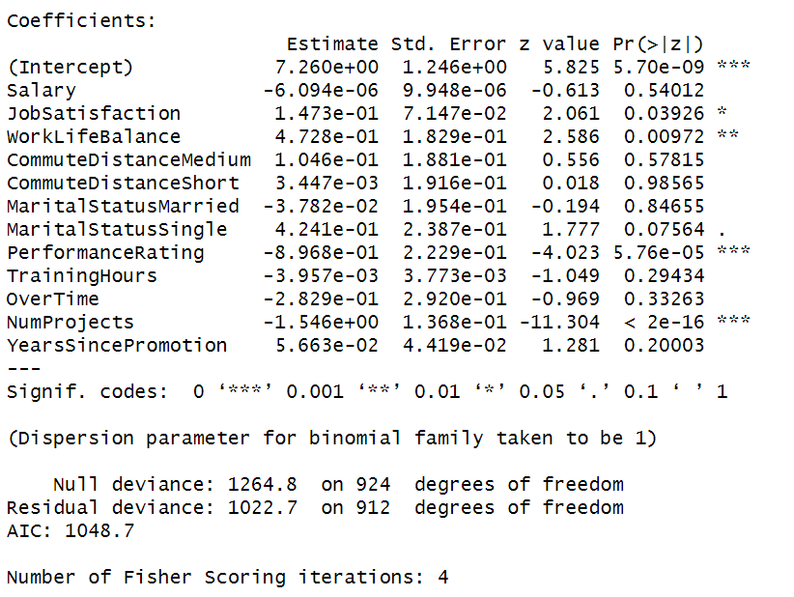
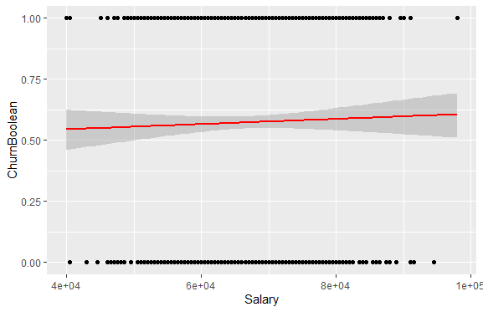
3.3 Interpretation of significancy and coefficient
OUTPUT:
Interpretation:
b₁ = -1.546
Therefore, Odds Ratio= e^{b1} = e^{-1.546} = 0.213
Which means,
An increase of 1 Project decreases the odds of the employee leaving by a factor of 0.213.
An increase of 1 Project is associated with decrease of the odds of the employee leaving the company by (1-0.213)=78.7%.

Slide 17
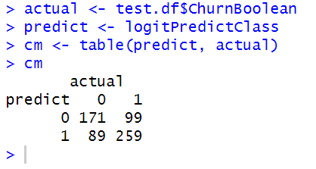
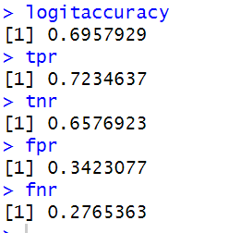
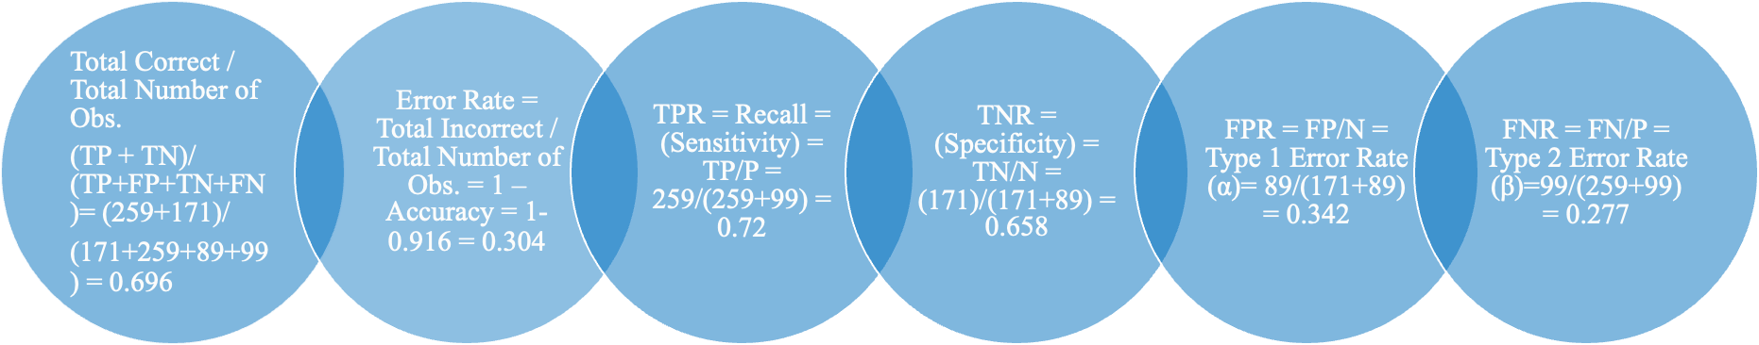
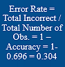
3.4 Accuracy on the training & test data
INPUT:
OUTPUT:
*Overall Performance Accuracy (0.696)

Slide 18

So… “keep doing Analytics”
That’s what we said!
Thank You!

